Slide 1
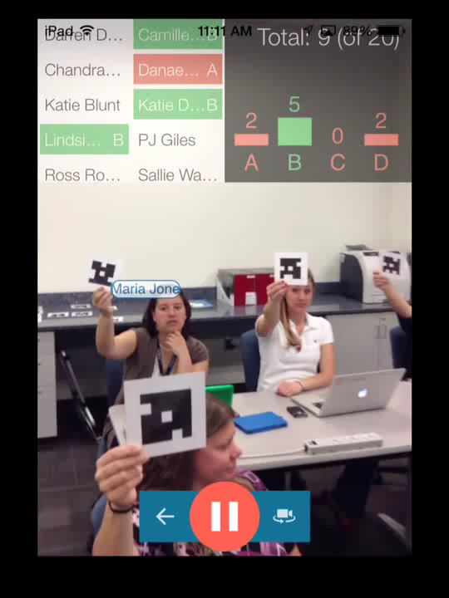
From Clickers to Plickers:
A cost-effective solution to foster active learning in COMP3500
Pickup your Plicker card now!
Notes:
2018 Fall: 50 Minutes slides 1-25

Slide 2
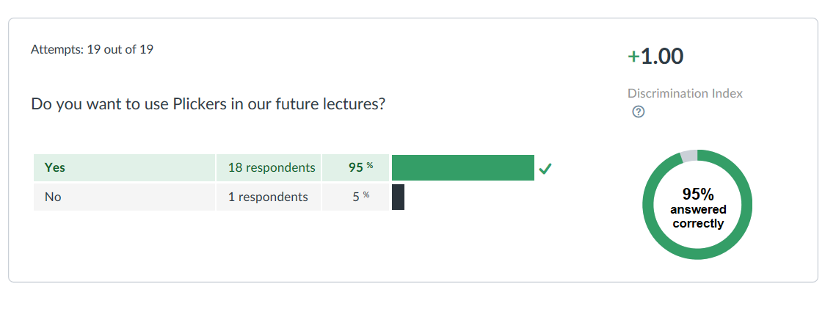
COMP3500 Fall’16 Student Feedback on Plickers

Slide 3
COMP 3500 Introduction to Operating Systems
Dr. Xiao Qin
Auburn University http://www.eng.auburn.edu/~xqin
xqin@auburn.edu

Slide 5
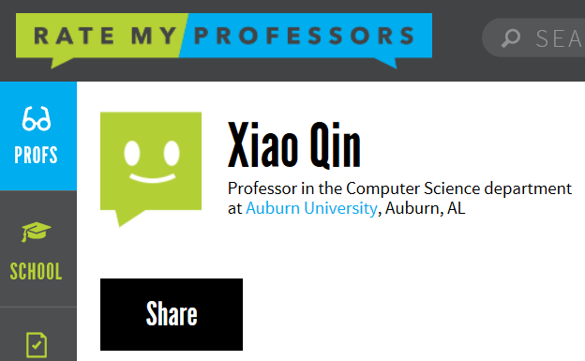
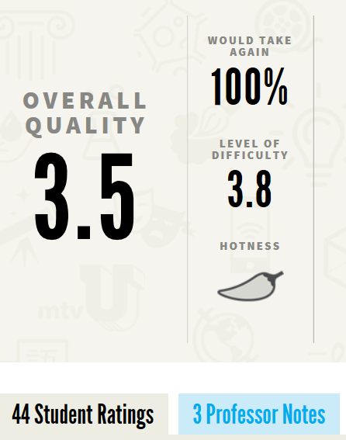


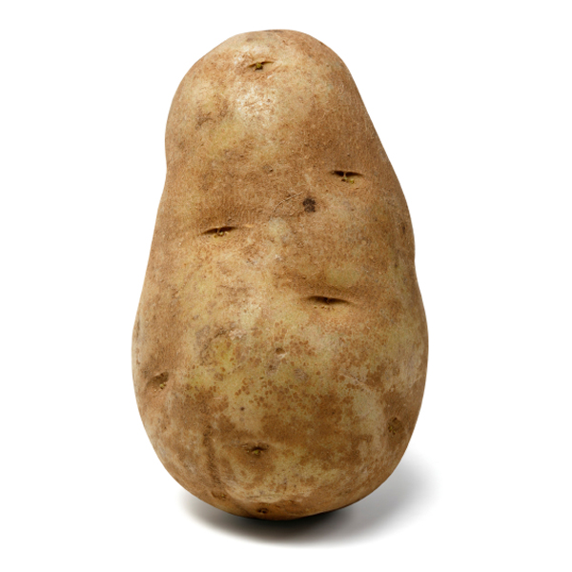
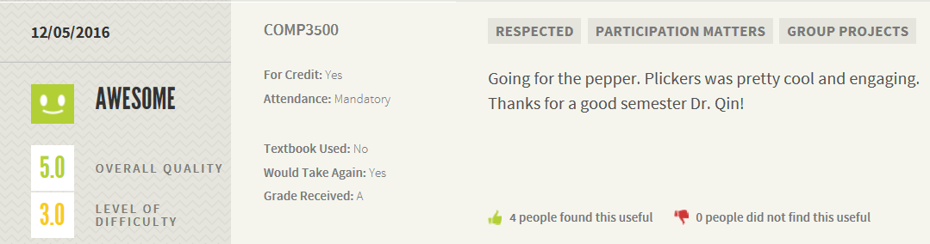

Slide 8

Build your plicker team now!
Each team has two (2) members
Discussions:
Set regular meeting time (at least twice a week)
Discuss collaboration software (e.g., google docs, dropbox, box, onedrive)
General collaboration strategies
Return your discussion minutes:
Names of your team members
Weekly meeting time
Collaboration software
Notes:
OS/161 is an operating system on which you will be working, whereas System/161 is a machine simulator on which the OS/161 runs.
Programming styles
README
Documents for interviews
Demonstration

Slide 9
Your Background (Not-A-Quiz)
What is your major (CS, SE, ECE, Wireless)?
Is this course an elective or a required course for you?
What programming languages do you have (any) experience in (Java, C, Python, C++, C#, Objective-C, Ruby, JavaScript, SQL)?
What is your favorite programming language (not necessarily the one you are the most skilled at)?
What is your experience of using the Linux operating system?
Have you taken Dr. Qin’s COMP271 class?

Slide 10
Plickers: Question 1
What is your major?
Computer Science
Software Engineering
Electrical and Computer Engineering
Wireless Engineering

Slide 11
Plickers: Question 2
Is this course an elective or a required course for you?
Elective course
Required course

Slide 12
Plickers: Question 3
What is your favorite programming language?
Java
C/C++
Python
C# or Objective-C

Slide 13
Plickers: Question 4
What is your programming skill of the C language?
Very Good
Good
Fair
Poor

Slide 14
Plickers: Question 5
What is your experience of using the Linux operating system?
Very Good
Good
Fair
Poor

Slide 15
Plickers: Question 6
Have you taken Dr. Qin’s COMP2710, COMP3000, COMP4300, or COMP4710?
Yes
No

Slide 16
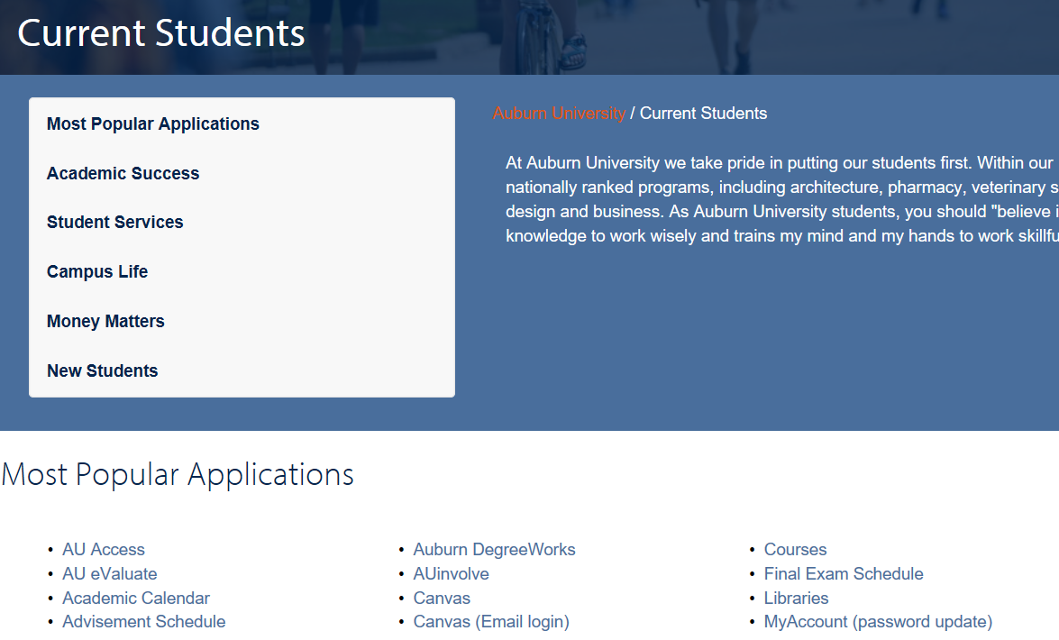

Slide 17
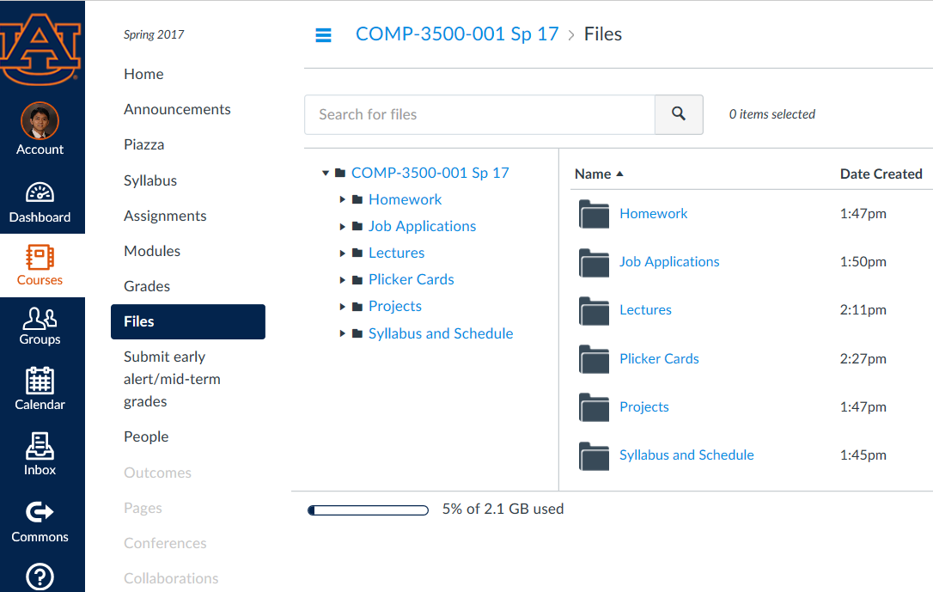

Slide 18
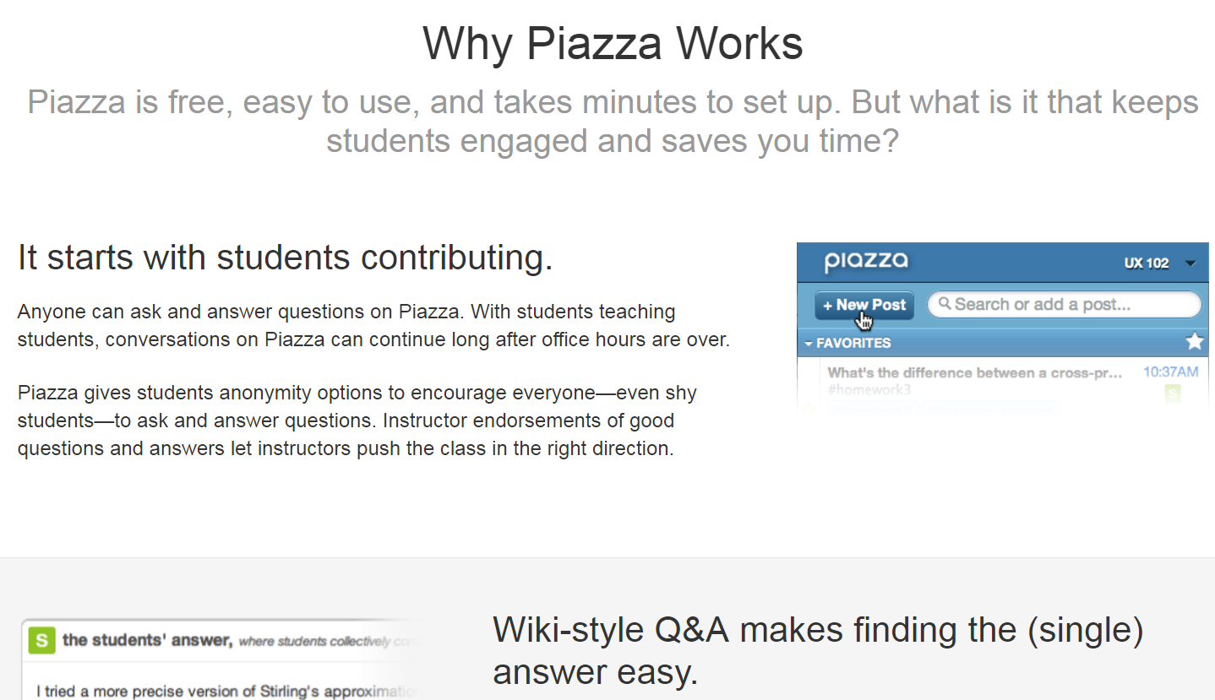
Notes:
Dr. Hendrix encouraged me to use Piazza.
piazzas Italian, piazze
[pyaht-tse] (Show IPA)1.an open square or public place in a city or town, especially in Italy.
New software tools: hothat

Slide 19

Piazza Awards
Andrew Stephen
Andrew Toomey
Brianna Roberts
Cory Evans
Jeremy Shepard
Mary Vo
Payton Walker
Xizhi Geng

Slide 20

Why Study Operating Systems?
Position | Software Development Engineer
Location | Redmond, WA
Company | Microsoft
Part of the Job Description | We are a small team that works on the core features of SQL Server including programmability, query execution, query optimization, storage, transactions, recovery, high availability, etc. 3-5 years of hands on software development. 3+ years’ experience C/C++/C#/Java coding skills. Strong Knowledge in distributed systems, databases, query processing, query optimization, cloud computing, operating systems

Slide 21

Why Study Operating Systems?
Position | Software Engineer
Location | San Francisco, CA
Company | Ebay
Part of the Job Description | The ideal candidate has experience building APIs to be consumed by website, mobile clients and third parties. You will be working on building services that form the backbone of one of the highest traffic ecommerce destinations. Qualifications include: 3-4 years experience in Python, Java, C++, Ruby Experience in building REST and/or XML APIs Knowledge in Object-Oriented Design Principles, Data Structures, Algorithms, relational databases, SQL, Operating Systems

Slide 22

Why Study Operating Systems?
Position | Mainframe Systems Engineer at the high-performance group
Location | Columbus, OH
Company | JPMorgan Chase
Part of the Job Description | This individual will be responsible for engineering support of JPMC's Operating systems and subsystems, which include zSeries, JES2, and Unix Systems Services. Requirements: experience installing, configuring, implementing, tuning, and debugging zSeries operating system hands-on experience in a z/OS operating system environment using JES2. experience in Unix Systems Services
Notes:
This deep-skill position will be a member the Mainframe Operating Systems Engineering team.

Slide 23

Why Study Operating Systems?
Position | Data Center Test Engineer
Location | Council Bluffs, IA
Company | Google
Part of the Job Description | Responsibilities: Define, plan, and set up test environments and infrastructure to test PC and network solutions in a Data Center. Plan, execute, and document tests to verify and validate systems integration, expose issues, and identify root causes. Requirements: BS degree in Computer, Electrical, Software Engineering, Computer Science or equivalent practical experience. 4 years of experience with Linux or Unix operating systems.

Slide 24

Notes:
Why Study Operating Systems?

Slide 25
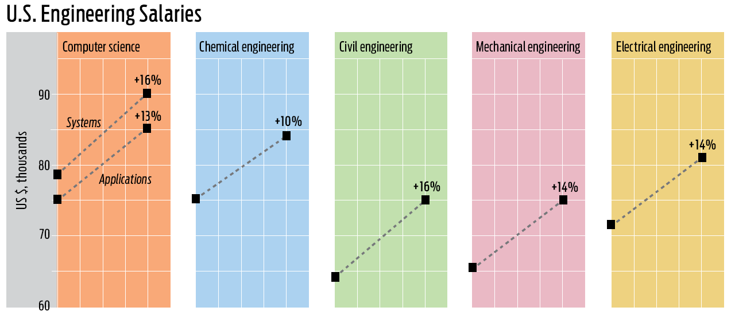
Notes:
Salary: System 6.25% higher than application

Slide 26
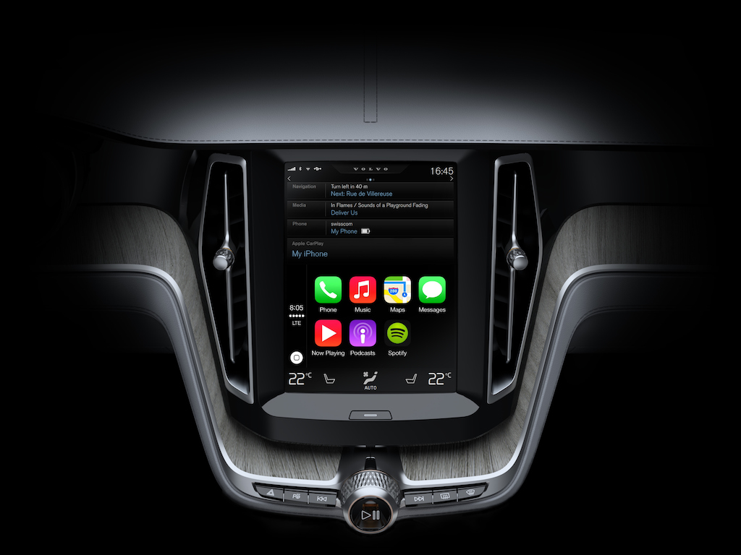
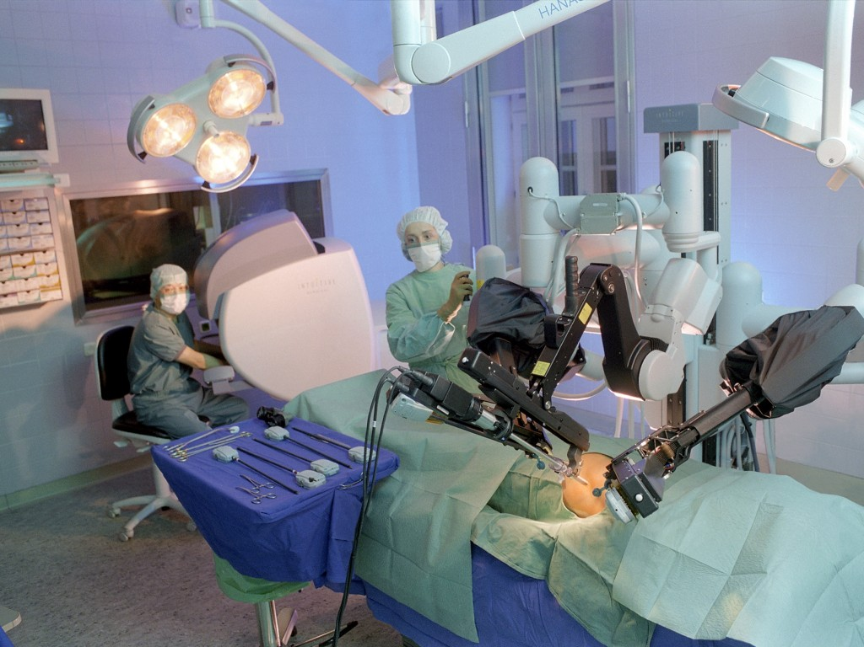
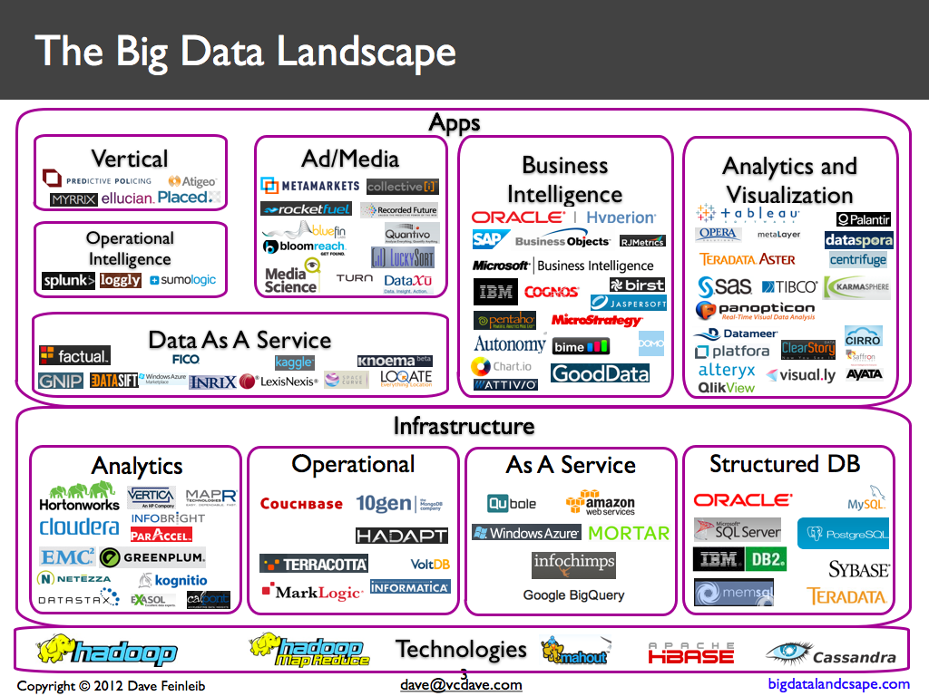
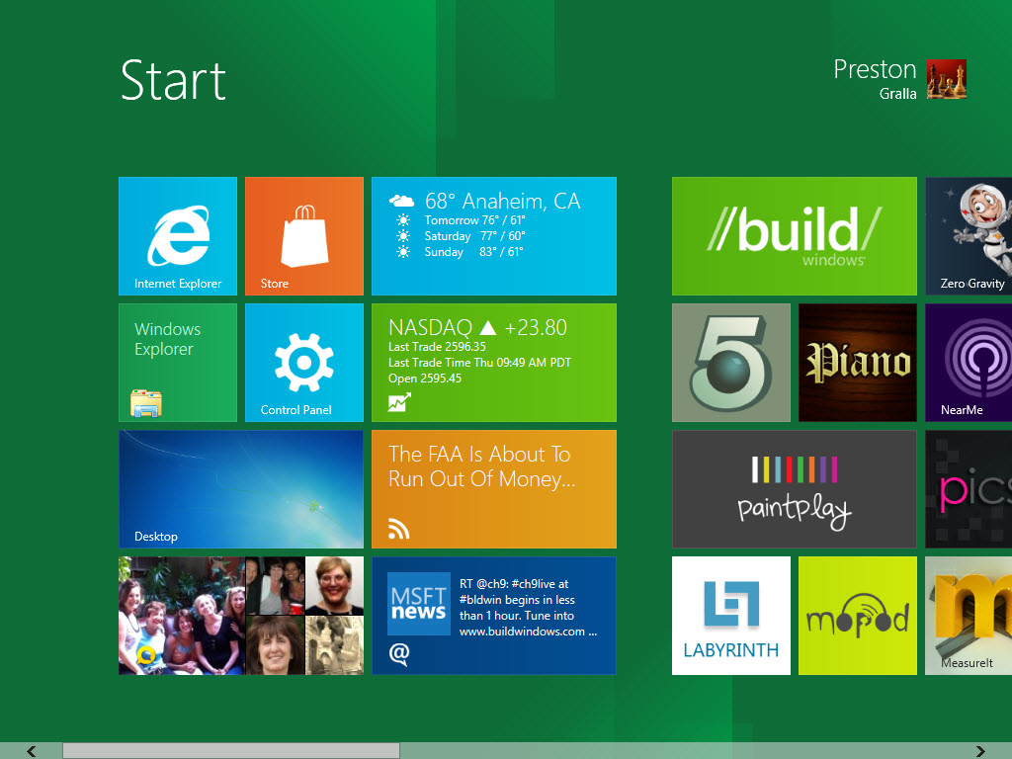
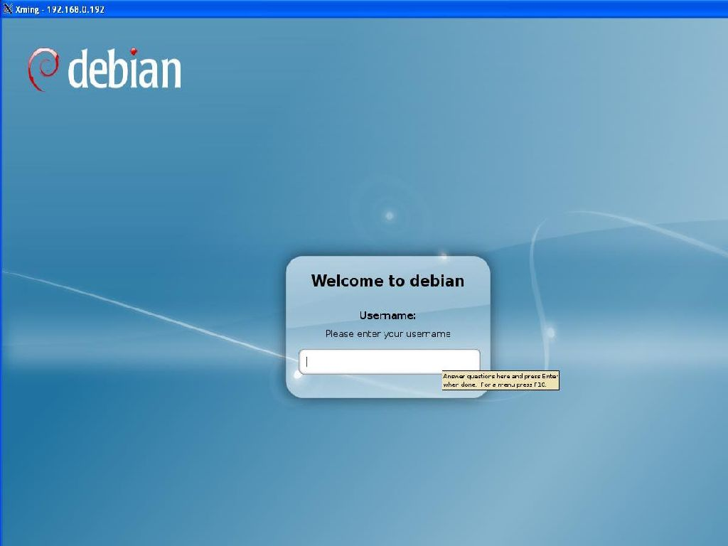
Operating Systems are Everywhere
Notes:
Reference: http://www.computerhope.com/os.htm
Operating system types
As computers have progressed and developed so have the operating systems. Below is a basic list of the different operating systems and a few examples of operating systems that fall into each of the categories. Many computer operating systems will fall into more than one of the below categories.
GUI - Short for Graphical User Interface, a GUI Operating System contains graphics and icons and is commonly navigated by using a computer mouse. See the GUIdefinition for a complete definition. Below are some examples of GUI Operating Systems.
System 7.x Windows 98 Windows CE
Multi-user - A multi-user operating system allows for multiple users to use the same computer at the same time and different times. See the multi-user definition for a complete definition for a complete definition. Below are some examples of multi-user operating systems.
Linux Unix Windows 2000
Multiprocessing - An operating system capable of supporting and utilizing more than one computer processor. Below are some examples of multiprocessing operating systems.
Linux Unix Windows 2000
Multitasking - An operating system that is capable of allowing multiple software processes to run at the same time. Below are some examples of multitasking operating systems.
Linux Unix Windows 2000
Multithreading - Operating systems that allow different parts of a software program to run concurrently. Operating systems that would fall into this category are:
Linux Unix Windows 2000
Robot OS
Dashboard OS: Apple’s CarPlay interface in the upcoming Volvo XC90 SUV. Image courtesy Volvo
Andriod

Slide 27
Your Future Career
Careers: Comp. Sci & Eng., Electrical Eng.
Phone and On-site Interviews
Programming skills
Problem solving skills
Personality
COMP2710: Quickly learn a new programming language
Programming experience
COMP3500: Quickly learn and implement new concepts
Notes:
Personality: teamwork.

Slide 28
Goal and Objectives
Goal: Compete for positions in the job market or in graduate schools.
Software design skills
Programming skills
Objective 1: Design system software (e.g., Project 4 Processes and System Calls)
Objective 2: Implement software at low levels (e.g., Project 3 synchronization)

Slide 29
Compilers
Parallel and Distributed Systems
COMP 3500 Introduction to Operating Systems
COMP 3350 Computer Organization
COMP 2710 Software Construction
Notes:
COMP 3350 Computer Organization and Assembly Language Programming

Slide 30
What will you get out of COMP3500?
Concepts
Synchronization
To learn the fundamental and components of operating systems
To implement a synchronization mechanism
Virtual Memory
File System
To construct a virtual memory management module
To implement a simple file system
Performance
Evaluate operating system performance

Slide 31
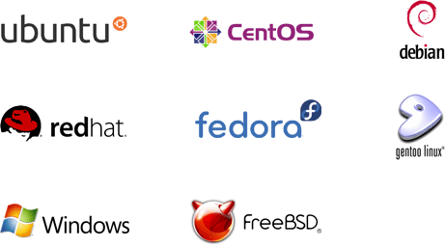
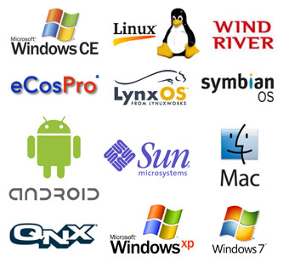
Topic Coverage
Concepts of processes/threads
Process scheduling
Concurrency problems
Synchronization
Mutual exclusion
Deadlocks
Memory management
File systems
Storage systems
Notes:
These topics may change

Slide 32
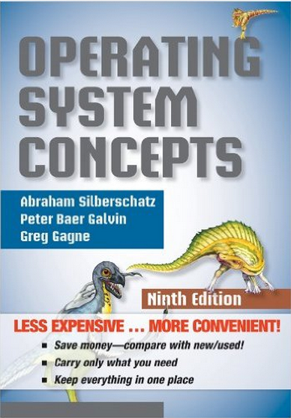



Textbook
Textbook: Operating System Concepts 9th Edition, Authors: Abraham Silberschatz, Peter B. Galvin, and Greg Gagne. ISBN-13: 978-1118063330, ISBN-10: 1118063333.

Slide 33
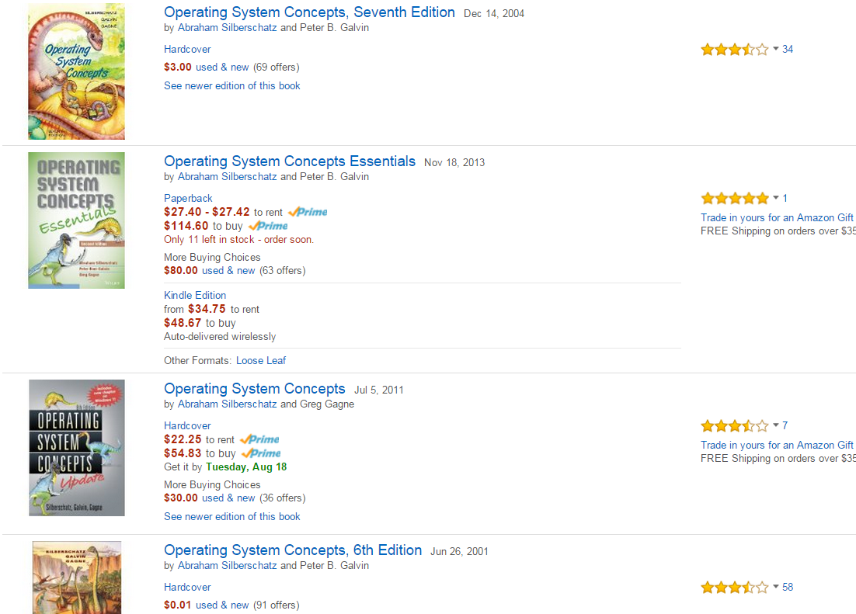
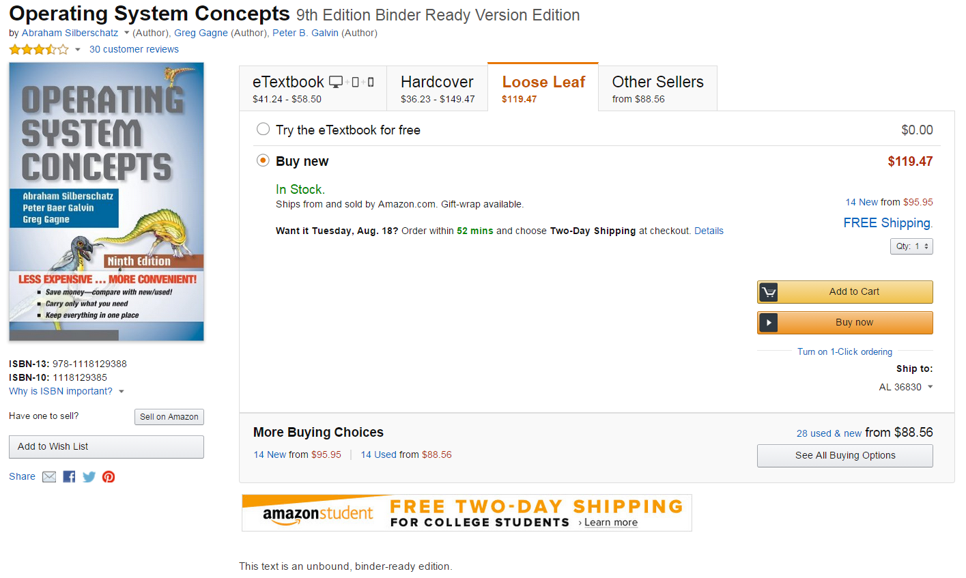
How to save money?
An Earlier Edition Works!

Slide 34

Pickup your CentOS CD after class
One member of each team pickups a CentOS CD from Dr. Qin after today’s class
Embark on Project 1 today!
Notes:
OS/161 is an operating system on which you will be working, whereas System/161 is a machine simulator on which the OS/161 runs.
Programming styles
README
Documents for interviews
Demonstration

Slide 35
Course Syllabus
Prerequisite:
COMP 2710 Software Construction
COMP 3350 Computer Organization and Assembly Language Programming
2 midterm exams and 1 final exam
Grading
Mid-term 1 13.3%
Mid-term 2 13.3%
Final Exam 13.4%
Quizzes 10%
Homework 10%
Programming Projects 40%
40%
Notes:
The syllabus is available on the course web site.
Read syllabus carefully after class
Prerequisite: Ask students’ background in assembly languages

Slide 36
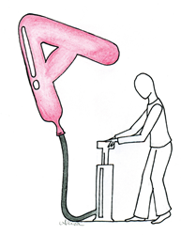

Course Syllabus (cont.)
Scale
Letter grades will be awarded based on the following scale. This scale may be adjusted upwards if it is necessary based on the final grades.
A [90, 100], B [80,90), C [70,80), D [60,70), F [0,60)
Cheating
Programming projects and written assignment are completed in teams of three.
Students in one group should NOT share any project code or even detailed algorithm information with students in other groups.
Assignments submitted must be your team.
Please do NOT attempt to recycle answers from the Internet (plagiarism).
Notes:
The syllabus is available on canvas.
Read syllabus carefully after class
Prerequisite: Ask students’ background in assembly languages
Possible penalties: Zero on assignment (minimum), failure course, note on permanent record, suspension.

Slide 37
Complaints?
If you have any complaint against Dr. Qin throughout this semester, please report to Dr. Narayanna or Dr. Hendrix.

Slide 38

Office Hours
Instructor: Dr. Xiao Qin, xqin@auburn.edu
Office: 3101E Shelby Center
Office Hours: MWF, 1:00 am – 1:50 am
TA: Jianzhou Mao, jzm0122@auburn.edu
Office Hour: MWF 3:00 pm-4:00 pm
Office: 2104 Shelby Center
Vote For Your Favorite Time Slot

Slide 39
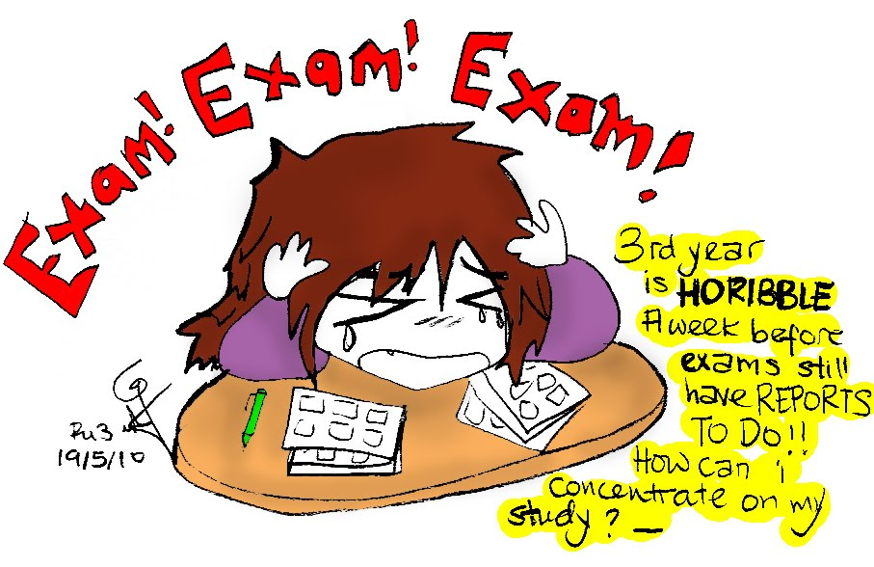

Three Exams
Mid-term Exam 1: 9/25, Monday, 11:00 am - 11:50 am
Mid-term Exam 2: 11/3, Friday, 11:00 am-11:50 am
Final Exam: 5/5, Friday, 8:00am-10:30am

Slide 40
Am I going to read the book or slides to you?
NO!
Book provides a framework and complete background, so lectures can be more interactive.
You do the reading
We’ll discuss it
Programming assignments will go “beyond”
Notes:
Teach students how to take notes.

Slide 41
Programming Assignments
Six programming assignments (40% of final score)
Programming language (C)
We will be using OS/161 and System/161.
We will learn two tools: CVS and GDB.
Assignment 1 Setup your Linux machine
Assignment 2 Starting with OS/161
Assignment 3 Synchronization
Assignment 4 Processes and System Calls
Assignment 5 Virtual Memory
Assignment 6 File Systems
Notes:
All projects should be made to compile under a compiler on Linux.
OS/161 is an operating system on which you will be working, whereas System/161 is a machine simulator on which the OS/161 runs.
Programming styles
README
Documents for interviews
Demonstration

Slide 42
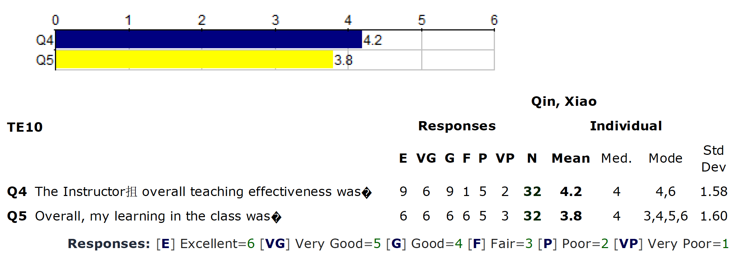
COMP3500 Course Evaluation Fall 2014
Projects were too much to finish and hard to understand
It is discouraging to not be able to get a project working properly.
Assume that the students can solve complex problems in C
Doesn't even teach practical uses of the Linux OS (ssh, vi)
Read slides

Slide 43
COMP3500 Course Evaluation Fall 2015

Slide 44
COMP3500 Course Evaluation Fall 2016
To teach the material needed for the projects as soon as they are released
Referencing the textbook would have greatly helped understanding.
Project 4 was both too deep and broad to do in a single month.

Slide 45
COMP3500 Course Evaluation Spring 2017
This was not an easy class by any means but I enjoyed it overall.
Using CVS was a nightmare.

Slide 46
A Comment from a Former COMP3500 Student
The projects are time consuming, but the effort one needs to put into the labs to receive a good grade is not the nightmare one might think.
It's arguable that the grading for labs are based more on the
demonstrated effort of a group to both work together AND to learn the material than it is to actually complete the lab to
100% perfection.

Slide 47

Questions
Please ask at any time!

Slide 48
For Next Time…
The first project has been released
Operating System Overview
Read Chapter 2
Notes:
How hard to build
Importance of simplicity (wearing a seat belt); avoiding a personal disaster
Theory vs. practice

Slide 49
Build your OS development team
Each team has three (3) members
Discussions:
Set regular meeting time (at least twice a week)
Discuss collaboration software (e.g., google docs, dropbox, box, onedrive)
General collaboration strategies
Return your discussion minutes:
Names of your team members
Weekly meeting time
Collaboration software
Notes:
OS/161 is an operating system on which you will be working, whereas System/161 is a machine simulator on which the OS/161 runs.
Programming styles
README
Documents for interviews
Demonstration

